Slide 1

Data Leakage Detection by
R.Kartheek Reddy
09C31D5807
(M.Tech CSE)

Slide 2
Knowledge And Data Engineering
Data Leakage Detection appears on KNOWLEDGE AND DATA ENGINEERING, VOL. 22, NO. 3, MARCH 2010
Author : Panagiotis Papadimitriou, Member, IEEE, Hector Garcia-Molina, Member, IEEE

Slide 3
Focused Areas in Knowledge & Data Engineering
Data Mining
-- Knowledge Discovery in Databases (KDD)
-- Intelligent Data Analysis
Database Systems
-- Data Management
-- Data Engineering
Knowledge Engineering
-- Semantic Web
-- Knowledge-Based Systems
-- Soft Computing

Slide 4
What is Data Mining?
Many Definitions
  Non-trivial extraction of implicit, previously unknown and potentially useful information from data
  Exploration & analysis, by automatic or
  semi-automatic means, of large quantities of data
  in order to discover Meaningful patterns

Slide 5
Data Leakage Detection-Introduction
In the course of doing business, sometimes sensitive data must be handed over to supposedly trusted third parties. For example, a hospital may give patient records to researchers who will devise new treatments. We call the owner of the data the distributor and the supposedly trusted third parties the agents.
Our goal is to detect when the distributor’s sensitive data has been leaked by agents, and if possible to identify the agent that leaked the data.

Slide 6
Problem Setup And Notation
Entities and Agents:
A distributor owns a set T = {t1, . . . , tm} of valuable data objects. The distributor wants to share some of the objects with a set of agents U1, U2, ...,Un, but does not wish the objects be leaked to other third parties.
An agent Ui receives a subset of objects Ri ⊆ T,
determined either by a sample request or an explicit
request.

Slide 7
Problem Setup And Notation
Guilty Agents:
Suppose that after giving objects to agents, the distributor discovers that a set S ⊆ T has leaked. This means that some third party called the target, has been caught in possession of S. For example, this target may be displaying S on its web site, or perhaps as part of a legal discovery process, the target turned over S to the distributor.

Slide 8
Related Work
As far as the data allocation strategies are concerned,
our work is mostly relevant to watermarking that is
used as a means of establishing original ownership
of distributed objects.

Slide 9
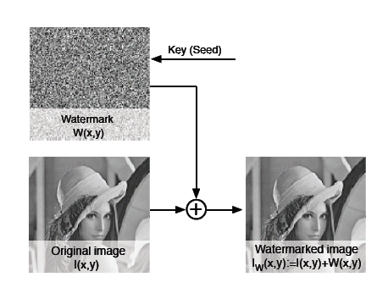
Related Work-Creating a Watermark

Slide 10
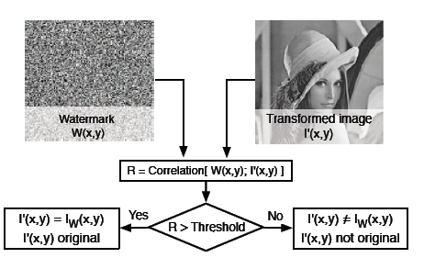
Related Work-Verifying a Watermark

Slide 11
Related Work
The main idea is to generate a watermark W(x; y) using a secret key chosen by the sender such that W(x; y) is indistinguishable from random noise for any entity that does not know the key (i.e., the recipients). The sender adds the watermark W(x; y) to the information object
(image) I(x; y) before sharing it with the recipient(s). It is then hard for any recipient to guess the watermark W(x; y) (and subtract it from the transformed image I0(x; y)); the sender on the other hand can easily extract and verify a watermark (because it knows the key).

Slide 12
Agent Guilt Model
To compute this Pr{Gi|S}, we need an estimate for the
probability that values in S can be “guessed” by the
target.
Assumption 1. For all t, t 1∈ S such that t = t1
provenance of t is independent of the provenance of t1.
Assumption 2. An object t ∈ S can only be obtained by the target in one of two ways:
• A single agent Ui leaked t from its own Ri set; or
• The target guessed (or obtained through other means) t without the help of any of the n agents.

Slide 13
Data Allocation Problem
The main focus of the paper is the data allocation problem: how can the distributor “intelligently” give data to agents in order to improve the chances of detecting a guilty agent?
The two types of requests we handle are sample and explicit. Fake objects are objects generated by the distributor that are not in set T. The objects are designed to look like real objects, and are distributed to agents together with the T objects, in order to increase the chances of detecting agents that leak data.

Slide 14
Existing System
The Existing System can detect the hackers but the total no of cookies (evidence) will be less and the organization may not be able to proceed legally for further proceedings due to lack of good amount of cookies and the chances to escape of hackers are high.

Slide 15
Proposed System
In the Proposed System the hackers can be traced with good amount of evidence. In this proposed system the leakage of data is detected by the following methods viz.., generating Fake objects, Watermarking and by Encrypting the data.

Slide 16
Software Requirements
Language : C#.NET
Technology : ASP.NET
IDE : Visual Studio 2008
Operating System : Microsoft Windows XP SP2
Backend : Microsoft SQL Server 2005

Slide 17
Hardware Requirements
Processor : Intel Pentium or more
RAM : 512 MB (Minimum)
Hard Disk : 40 GB

Slide 18
Conclusion
In a perfect world there would be no need to hand
over sensitive data to agents that may unknowingly or
maliciously leak it. And even if we had to hand over sensitive data, in a perfect world we could watermark each
object so that we could trace its origins with absolute
certainty.

Slide 19
References
R. Agrawal and J. Kiernan. Watermarking relational databases. In VLDB ’02: Proceedings of the 28th international conference on Very Large Data Bases, pages 155–166. VLDB Endowment, 2002.
P. Bonatti, S. D. C. di Vimercati, and P. Samarati. An algebra for composing access control policies. ACM Trans. Inf. Syst. Secur., 5(1):1–35, 2002.
P. Buneman, S. Khanna, and W. C. Tan. Why and where: Acharacterization of data provenance. In J. V. den Bussche andV. Vianu, editors, Database Theory - ICDT 2001, 8th International Conference, London, UK, January 4-6, 2001, Proceedings, volume 1973.

Slide 20
Thank You

